Slide 1
State Estimation of an Unmanned Ground Vehicle Using Inexpensive Sensors

Slide 2
Robot Localization
Find out where you are with respect to your environment
What is the environment?
Static map, given
Dynamic map generation
Use UTM grid as static map

Slide 3
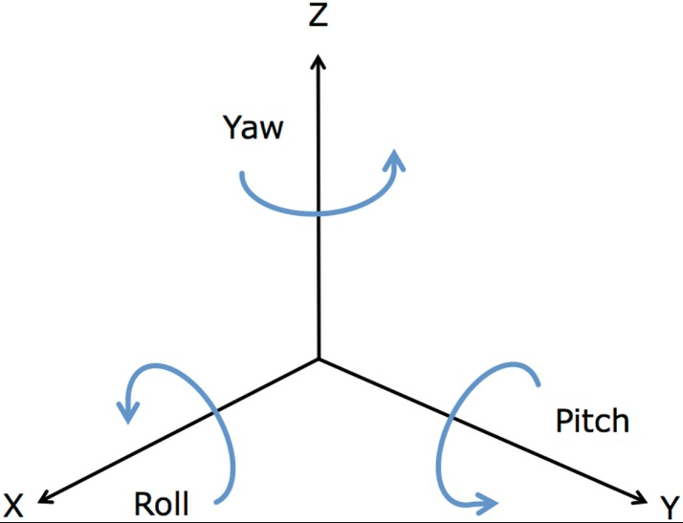
State Estimation
[10]
Combination of variables of interest
Positional Coordinates
Orientation
Linear and Angular Velocity
Linear Acceleration

Slide 4
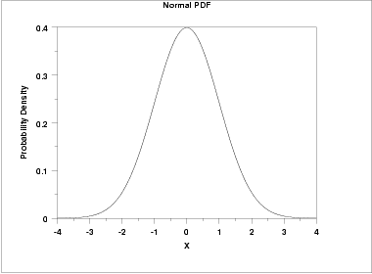
Belief Distributions
[1]
Probability Density Functions
Represent probability of every possible state across the state space
Captures uncertainty from
Noisy sensors
Noisy control hardware
Imprecise models

Slide 5
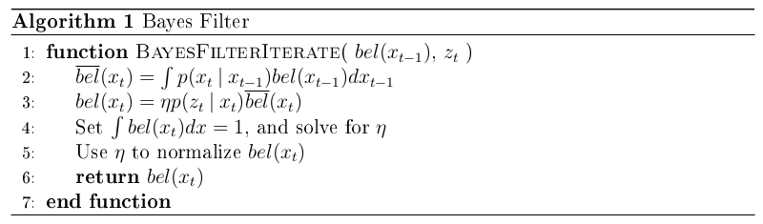
Bayes’ Filter
Recursive, iterative updates to belief given new sensor measurement
Prediction step, Update step
Two PDFs must be given

Slide 6
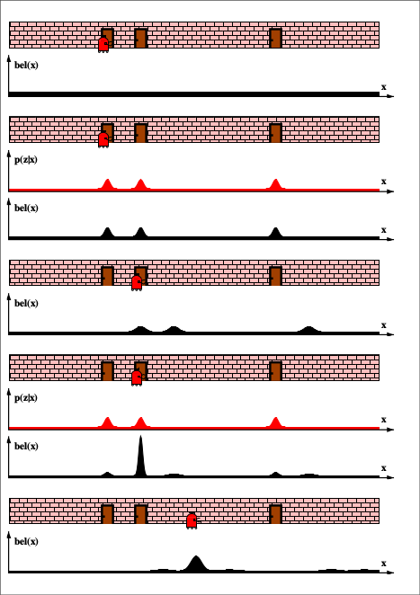
Example
Robot has static map of wall with three doors
Uses sensor to identify if it is in front of a door
[9]

Slide 7
Multivariate Normal Distribution
Class of PDFs of the form
x is a vector
E[X] is the mean of the PDF
Σ is the covariance matrix
Unimodal
Completely described by mean and covariance matrix
[1]

Slide 8
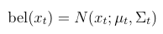
Extended Kalman Filter
Implements Bayes’ Filter by approximating all PDFs with multivariate normal distributions
G_{t} is the Jacobian of g evaluated at μ_{t-1}
H_{t} is the Jacobian of h evaluated at
R_{t} and Q_{t} are covariance matrices representing process and sensor noise

Slide 9
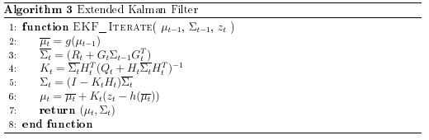
Extended Kalman Filter
Still has prediction and update step

Slide 10
Rover Design
Choose cheap and accessible parts (no LIDAR)
Need vehicle which works outdoors
Four-wheel base
no IR
Sensors
Two 100 Pulse-Per-Revolution motor encoders
An Android smartphone
Accelerometer, Gyroscope, Magnetometer
GPS Receiver
An ultrasonic distance sensor (unused)

Slide 11
Rover Design
Controls
Arduino microcontroller
Laptop
Sabertooth motor driver
Battery
Laptop powers Arduino
2 cell li-ion pack powers motor driver
Motor driver’s BEC powers sensors

Slide 12
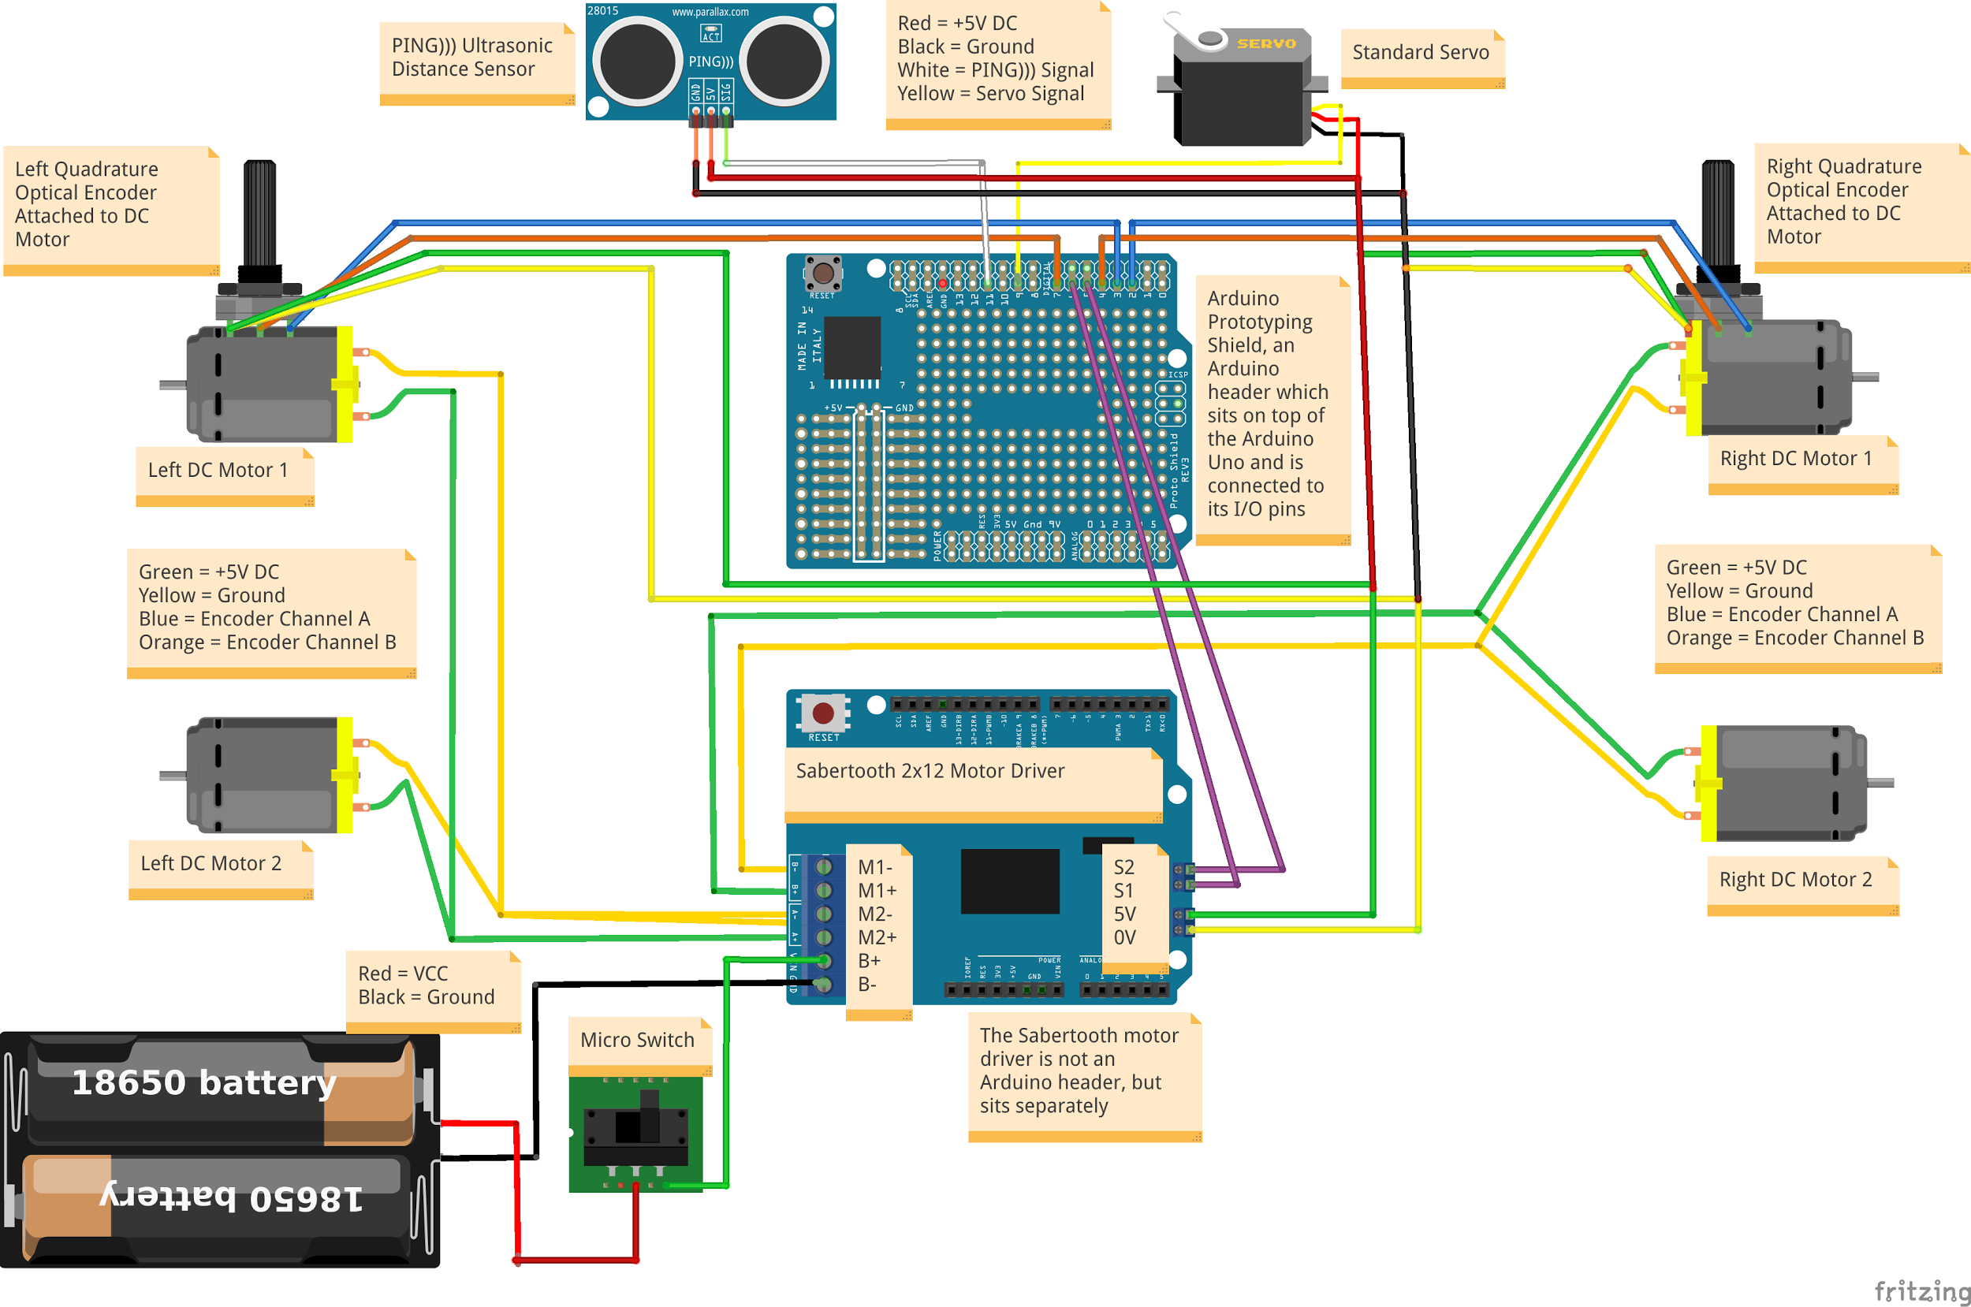
Made With Fritzing

Slide 13
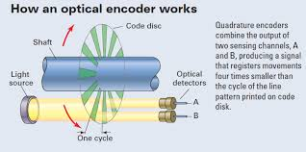
Wheel Encoders
Incremental Position Encoders
Optical Quadrature Encoders
[8]

Slide 14
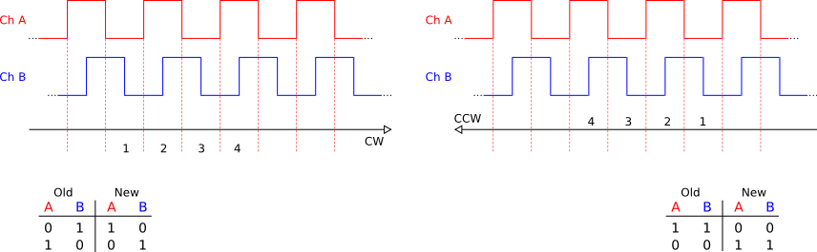
Decoding Output Pulses
[7]

Slide 15
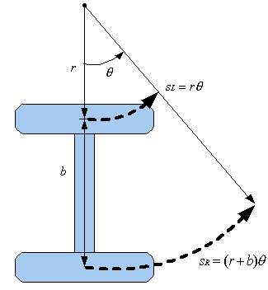
From pulses per revolution and wheel circumference, compute distance traveled by each wheel
Differential drive model
Two-wheeled robot
SM = (SL + SR) / 2
Θ = (SR - SL) / b
[6]

Slide 16
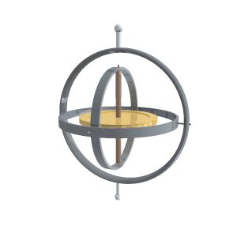
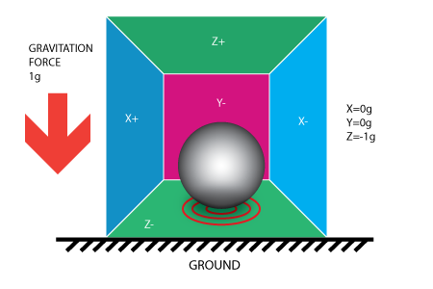
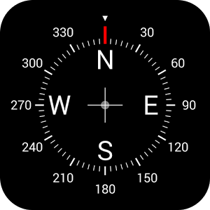
Inertial Measurement Unit
[5]
[2]

Slide 17
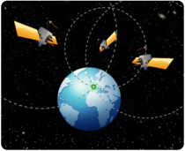
Global Positioning System
[4]
GPS Receiver in smartphone
Trilateration
Assisted GPS

Slide 18
Software
Robot Operating System
Meta OS
asynchronous messaging
shared robotics libraries
All software systems on laptop operate in ROS
Arduino Sketch
Controls servo
Forwards motor commands from laptop to motor driver
Counts encoder pulses and reports ticks to laptop
Android App
Publishes IMU data as ROS messages

Slide 19
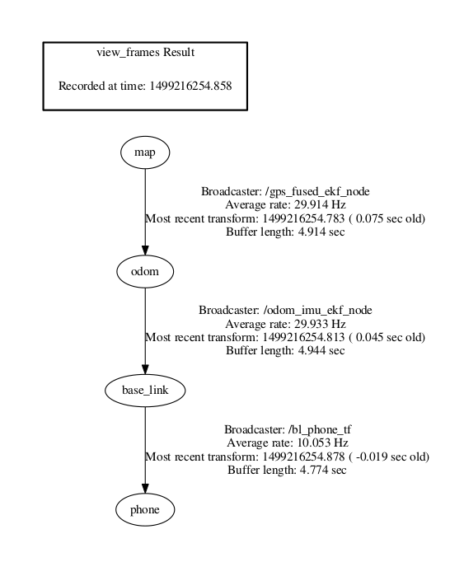
Frames
Frames are coordinate axes
Base_link
Rigidly attached to rover
X forward, Y left, Z up
Phone
Origin moves with rover
Orientation fixed at ENU
World-fixed frames
Odom
Map

Slide 20
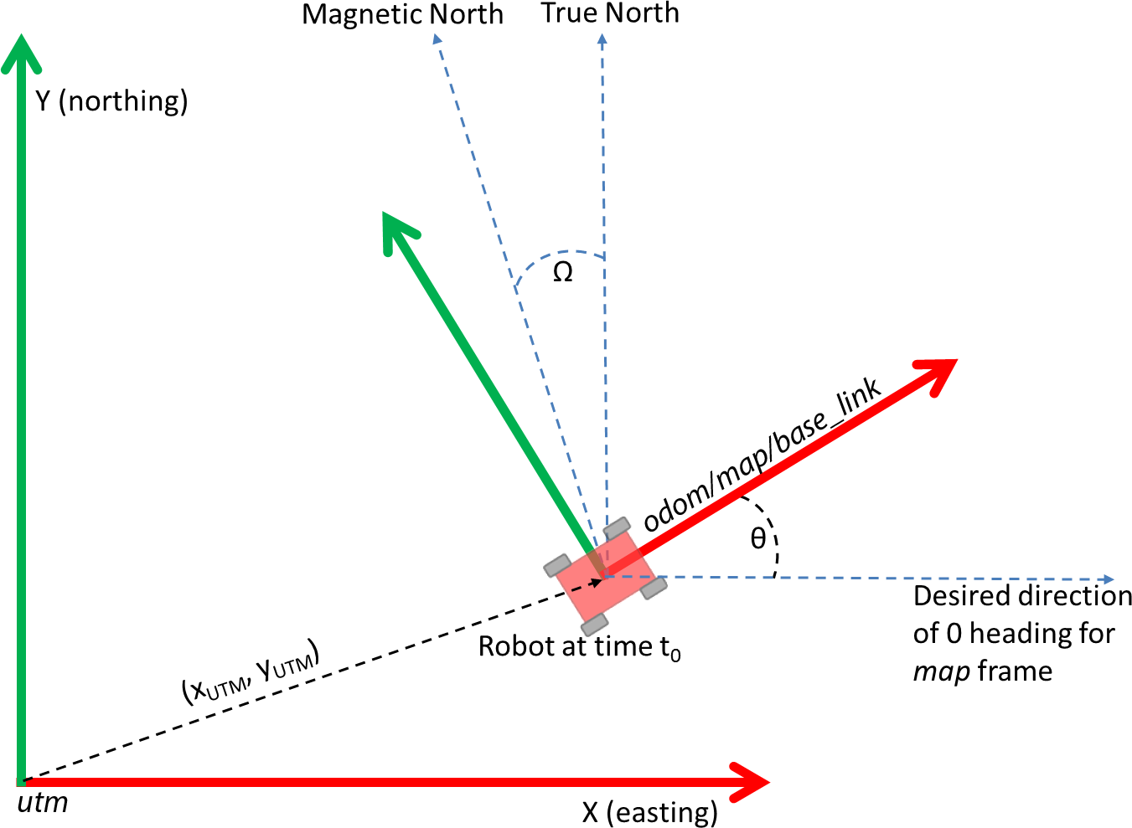
[3]

Slide 21
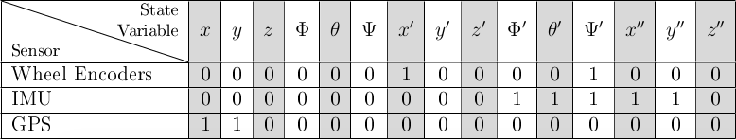
Field Test
Testing robot localization capability
Manually controlled rover from laptop
Loop around parking lot across from library
5-1/2 minute duration

Slide 22
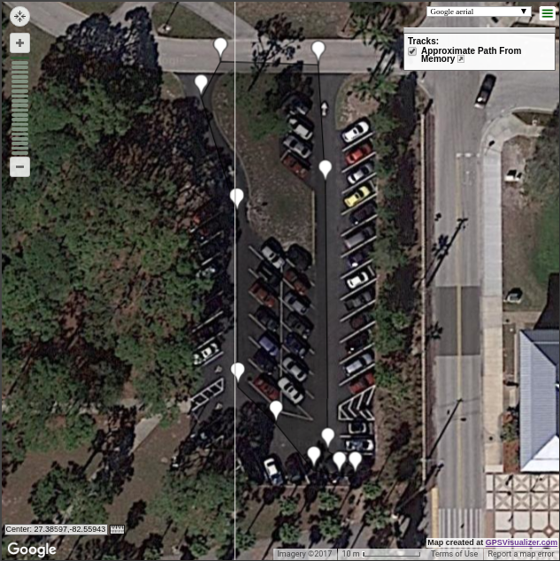
True Path
Manually created with Google Maps after collection

Slide 23
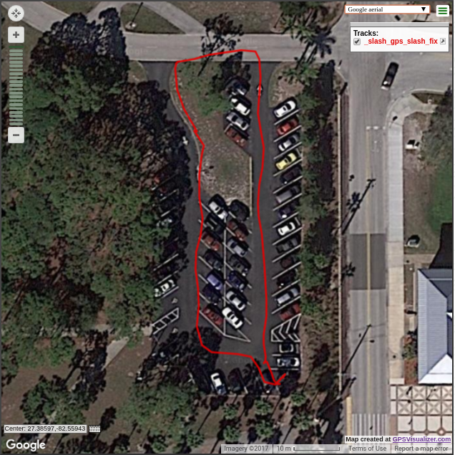
GPS
Rover never went onto the grass
Discrete data points, connected by GPSVisualizer tool

Slide 24
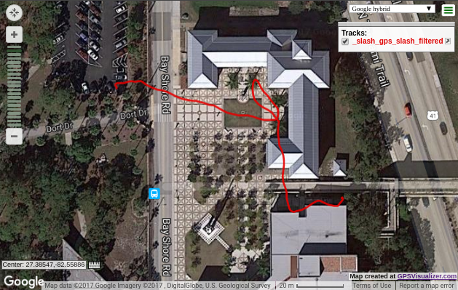
Wheel Odometry
Initial GPS coordinate and heading given
Wheel odometry calculated from wheel encoders fed into filter
Problems tracking yaw
Good estimate of distance traveled

Slide 25
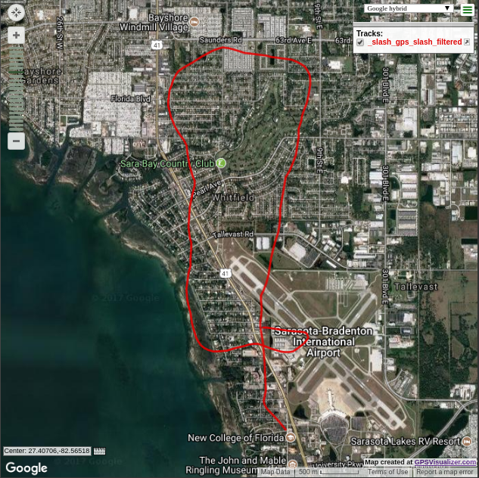
IMU
Problems tracking yaw
Big problem with distance traveled
Yaw is much better

Slide 26
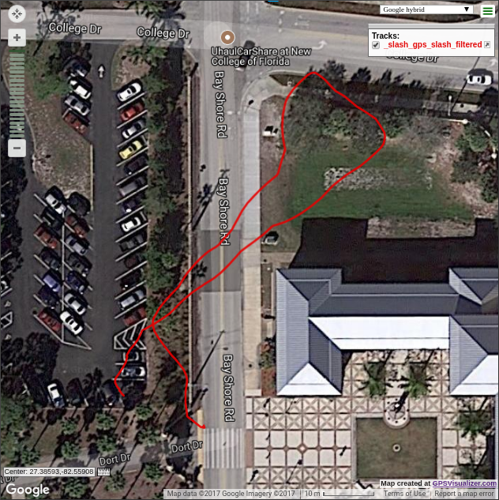
Odom + IMU
Fuse both prior data streams into the EKF

Slide 27
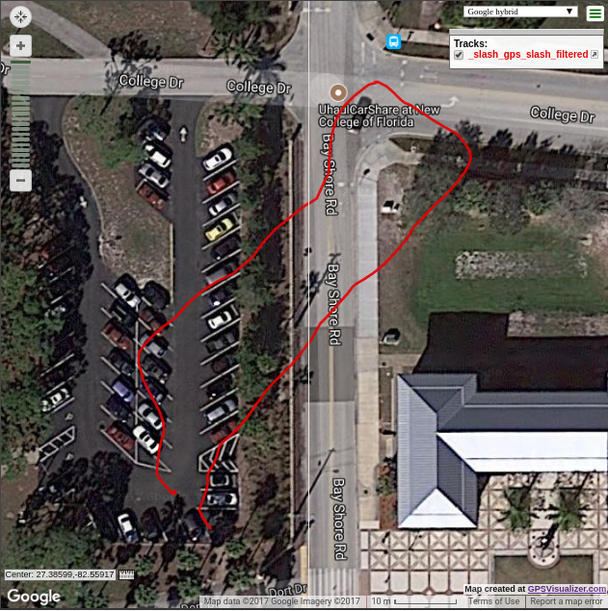
Odom (No Yaw) + IMU
Don’t use wheel odometry’s estimate of yaw velocity
Better shape

Slide 28
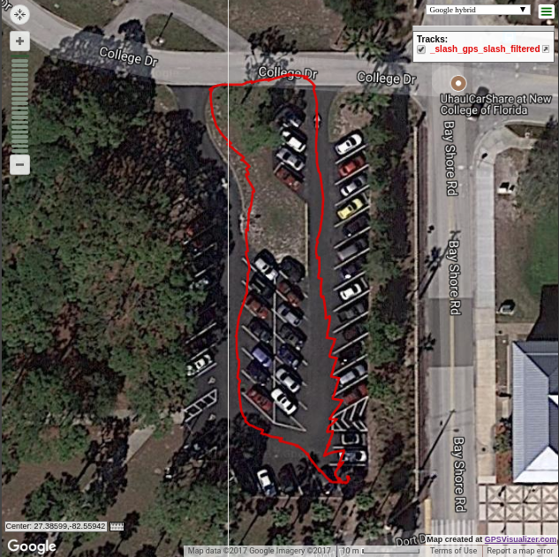
Odom + IMU + GPS
Take continuous estimate in odom frame, and fuse that estimate with gps fixes using a second EKF
Produces a discontinuous estimate in the map frame
Jagged edges are discontinuous jumps. The path looks continuous due to the GPSVisualizer tool

Slide 29
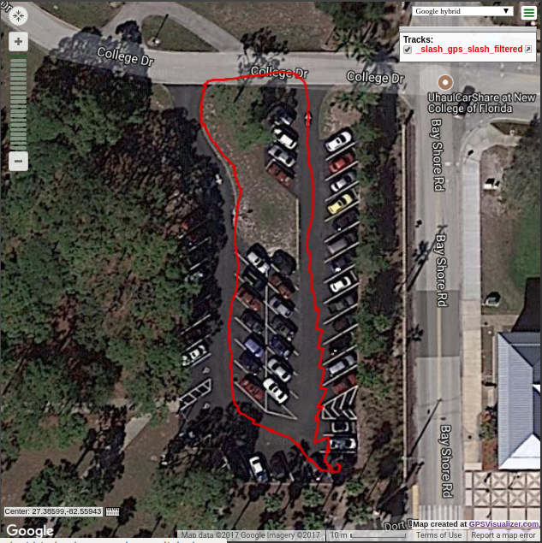
Odom (No Yaw) + IMU + GPS
Don’t use wheel odometry’s estimate of yaw velocity
Similar shape, but smoother

Slide 30
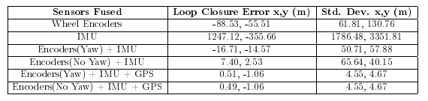
Loop Closure

Slide 31
Figure Citations
[1] NIST/SEMATECH e-Handbook of Statistical Methods. http://www.itl.nist.gov/div898/handbook/eda/section3/eda3661.htm
[2] http://www.instructables.com/id/Accelerometer-Gyro-Tutorial/
[3] Tom Moore. Robot_localization_wiki. http://docs.ros.org/kinetic/api/robot_localization/html/integrating_gps.html
[4] What is trilateration? http://www.mio.com/technology-trilateration.htm
[5] https://play.google.com/store/apps/details?id=com.vincentlee.compass
[6] G.W. Lucas. A Tutorial and Elementary Trajectory Model for the Differential Steering System of Robot Wheel Actuators. http://rossum.sourceforge.net/papers/DiffSteer/

Slide 32
Citations
[7] Nich Fugal. Efficiently Reading Quadrature With Interrupts. http://makeatronics.blogspot.com/213/02/efficiently-reading-quadrature-with.html
[8] Machine Design. quadrature-signals-encoders-basics. http://www.machinedesign.com/sites/machinedesign.com/files/uploads/2013/04/quadrature-signals-encoders-basics.ng
[9] Sebastian Thrun, Wolfram Burgard, and Dieter Fox. Probabilistic Robotics. The MIT Press, 2005.
[10] Katherine Ellis et al. Average roll, pitch, and yaw angles. https://www.researchgate.net/publication/262055313_Identifying_Active_Travel_Behaviors_in_Challenging_Environments_Using_GPS_Accelerometers_and_Machine_Learning_Algorithms

